Slide 1
Extended Entity Relationship (EER) Model
ER model has been widely used but have some shortcomings.
Difficult to represent cases where an entity may have varying attributes dependent upon some property.
ER model has been extended into Extended Entity Relationship model which includes more semantics such as generalization, categorization and aggregation.
115/11/08

Slide 2
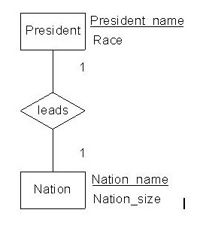
Cardinality: One-to-one relationship
A one-to-one relationship between set A and set B is defined as: For all a in A, there exists at most one b in B such that a and b are related, and vice versa.
Example
A president leads a nation.
Relational Model:
Relation President (President_name, Race, *Nation_name)
Relation Nation (Nation_name, Nation_size)
Where underlined are primary keys and "*" prefixed are foreign keys
Extended Entity Relationship model
115/11/08

Slide 3
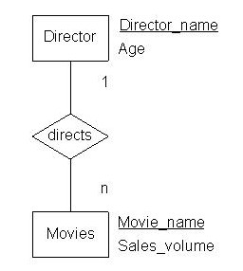
Cardinality: Many-to-one relationship
A many-to-one relationship from set A to set B is defined as: For all a in A, there exists at most one b in B such that a and b are related, and for all b in B, there exists zero or more a in A such that a and b are related.
Example A director directs many movies.
Relational Model:
Relation Director (Director_name, Age)
Relation Movies (Movie_name, Sales_volume, *Director_name)
Extended entity relationship model:
115/11/08

Slide 4
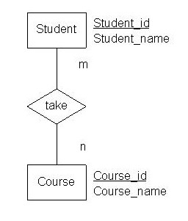
Cardinality: Many-to-many relationship
A many-to-many relationship between set A and set B is defined as: For all a in A, there exists zero or more b in B such that a and b are related, and vice versa.
Example
Many students take many courses such that a student can take many courses and a course can be taken by many students.
Relational Model:
Relation Student (Student_id, Student_name)
Relation Course (Course_id, Course_name)
Relation take (*Student_id, *Course_id)
Extended entity relationship model:
115/11/08

Slide 5
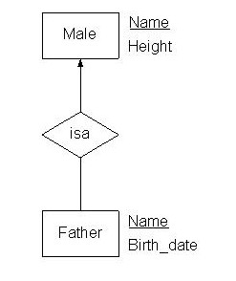
Data Semantic: Is-a (Subtype) relationship
The relationship A isa B is defined as: A is a special kind of B.
Example
Father is Male.
Relational Model:
Relation Male (Name, Height)
Relation Father (*Name, Birth_date)
Extended entity relationship model
115/11/08

Slide 6
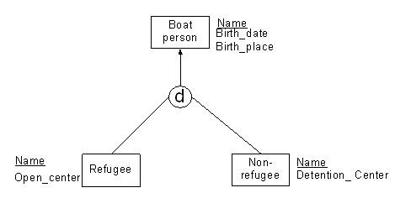
Data Semantic: Disjoint Generalization
-Generalization is to classify similar entities into a single entity. More than one is-a relationship can form data abstraction (i.e. super-class and subclasses) among entities.
- A subclass entity is a subset of its super-class entity. There are two kinds of generalization.
- The first is disjoint generalization such that subclass entities are mutually exclusive.
- The second is overlap generalization such that subclass entities can overlap each other.
Example of Disjoint Generalization
A refugee and a non-refugee can both be a boat person, but a refugee cannot be a non-refugee, and vice versa.
Relational Model:
Relation Boat_person (Name, Birth_date, Birth_place)
Relation Refugee (*Name, Open_center)
Relation Non-refugee (*Name, Detention_center)
Extended entity relationship model:
115/11/08

Slide 7
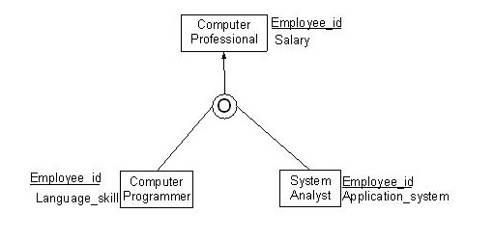
Data Semantic: Overlap Generalization
Example of Overlap Generalization
A computer programmer and a system analyst can both be a computer professional, and a computer
programmer can also be a system analyst, and vice versa.
Relational Model:
Relation Computer_professional (Employee_id, Salary)
Relation Computer_programmer (*Employee_id, Language_skill)
Relation System_analyst (*Employee_id, Application_system)
Extended entity relationship model:
115/11/08

Slide 8
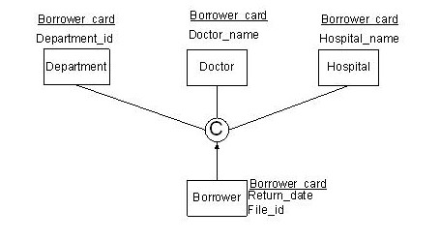
Data Semantic: Categorization Relationship
In cases the need arises for modeling a single super-class/subclass relationship with more than one super-class (es), where the super-classes represent different entity types. In this case, we call the subclass a category.
Relational Model:
Relation Department (Borrower_card, Department_id)
Relation Doctor (Borrower_card, Doctor_name)
Relation Hospital (Borrower_card, Hospital_name)
Relation Borrower (*Borrower_card, Return_date, File_id)
Extended Entity Relationship Model
115/11/08

Slide 9
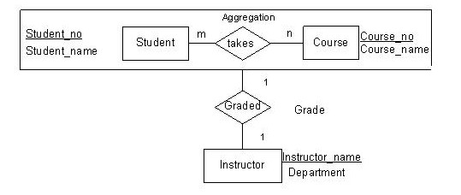
Data Semantic: Aggregation Relationship
Aggregation is a method to form a composite object from its components. It aggregates
attribute values of an entity to form a whole entity.
Example
The process of a student taking a course can form a composite entity (aggregation) that may be graded by an instructor if the student completes the course.
Relational Model:
Relation Student (Student_no, Student_name)
Relation Course (Course_no, Course_name)
Relation Takes (*Student_no, *Course_no, *Instructor_name)
Relation Instructor (Instructor_name, Department)
Extended Entity Relationship Model
115/11/08

Slide 10
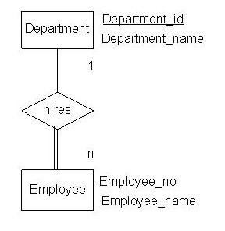
Data Semantic: Total Participation
An entity is in total participation with another entity provided that all data occurrences of the entity must participate in a relationship with the other entity.
Example
An employee must be hired by a department.
Relational Model:
Relation Department (Department_id, Department_name)
Relation Employee (Employee_id, Employee_name, *Department_id)
Extended entity relationship model:
115/11/08

Slide 11
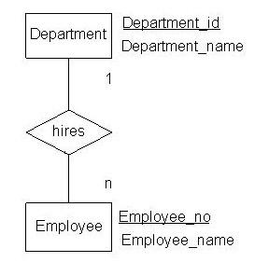
Data Semantic: Partial Participation
An entity is in partial participation with another entity provided that the data occurrences of the entity are not totally participate in a relationship with the other entity.
Example
An employee may be hired by a department.
Relational Model:
Relation Department (Department_id, Department_name)
Relation Employee (Employee_no, Employee_name, &Department_id)
Where & means that null value is allowed
Extended entity relationship model:
115/11/08

Slide 12
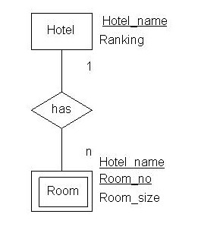
Data Semantic: Weak Entity
The existence of a weak entity depends on its strong entity.
Example
A hotel room must concatenate hotel name for identification.
Relational Model:
Relation Hotel (Hotel_name, Ranking)
Relation Room (*Hotel_name, Room_no, Room_size)
Extended entity relationship model
115/11/08

Slide 13
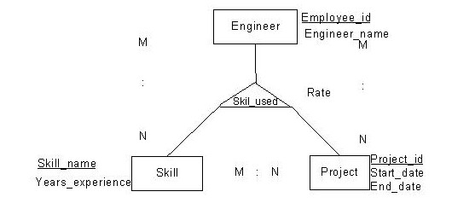
Cardinality: N-ary Relationship
Multiple entities relate to each other in an n-ary relationship.
Example
Employees use a wide range of different skills on each project they are associated with.
Relational Model:
Relation Engineer (Employee_id, Employee_name)
Relation Skill (Skill_name, Years_experience)
Relation Project (Project_id, Start_date, End_date)
Relation Skill_used (*Employee_id, *Skill_name, *Project_id)
Extended entity relationship model:
115/11/08

Slide 14
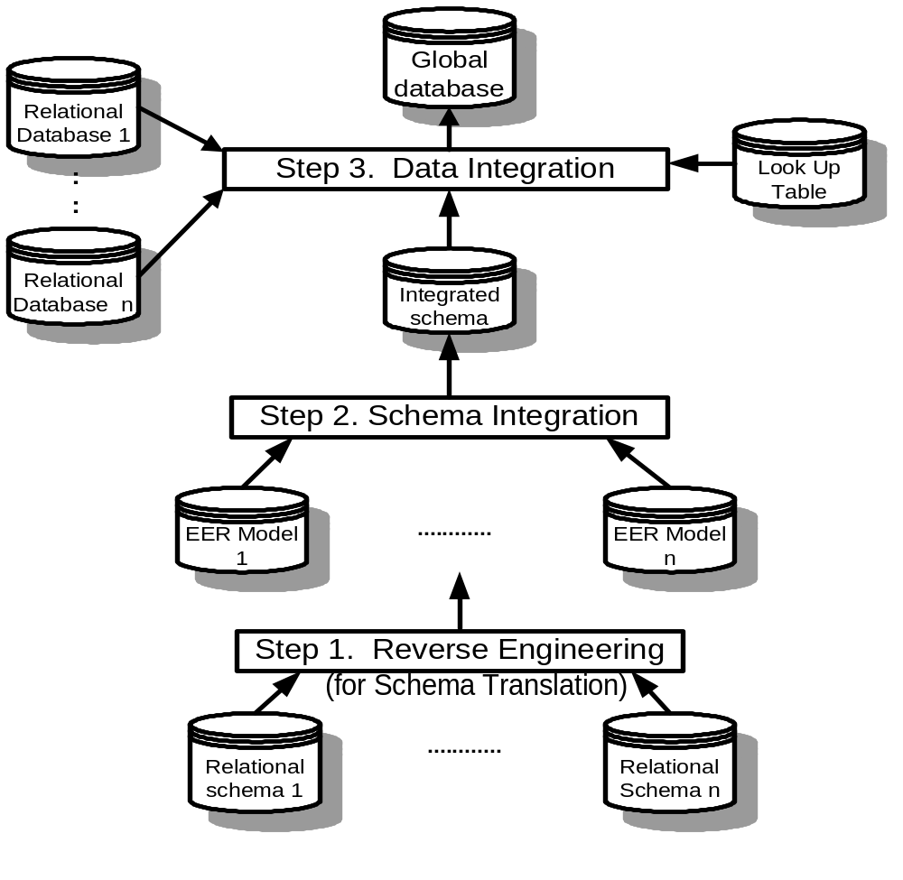
Architecture of multiple databases integration
115/11/08

Slide 15
Reverse engineering
relational schema into EER model
Step 1 Defining each relation, key and field:
1) The relations are preprocessed by making any necessary candidate key substitutions as follows:
Primary relation: describing entities.
  Primary relation - Type 1 (PR1). This is a relation whose primary key does not contain a key of another relation.
  Primary relation - Type 2 (PR2). This is a relation whose primary key does contain a key of another relation.
115/11/08

Slide 16
Secondary relation: a relation whose primary key is fully or partially formed by concatenation of primary keys of other relations.
  Secondary relation - Type 1 (SR1). If the key of the secondary relation is formed by concatenation of primary keys of primary relations, it is of Type 1 or SR1.
  Secondary relation - Type 2 (SR2). Secondary relations that are not of Type 1.
Key attribute - Primary (KAP). This is an attribute in the primary key of a relation, and is also a foreign key of another relation.
Key attribute - General (KAG). These are all the other primary key attributes in a secondary relation that are not of the KAP type.
115/11/08

Slide 17
Foreign key attribute (FKA). This is a non-primary-key attribute of a primary relation that is a foreign key.
Nonkey attribute (NKA). The rest of the non-primary-key attribute.
Step 2 Map each PR1 into entity
For each Type 1 primary relation (PR1), define a corresponding entity type and identify it by the primary key. Its nonkey attributes map to the attributes of the entity types with the corresponding domains.
115/11/08

Slide 18
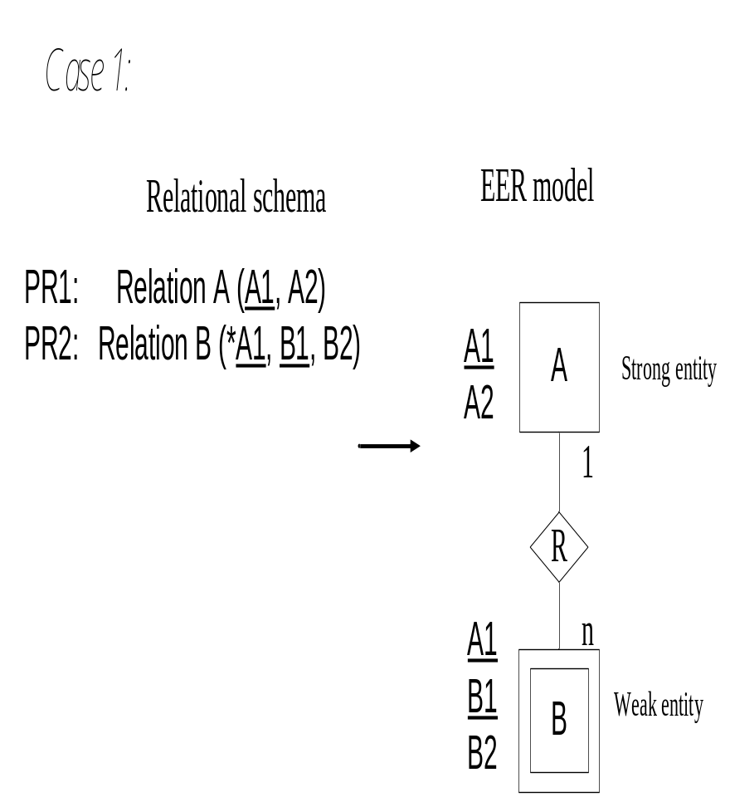
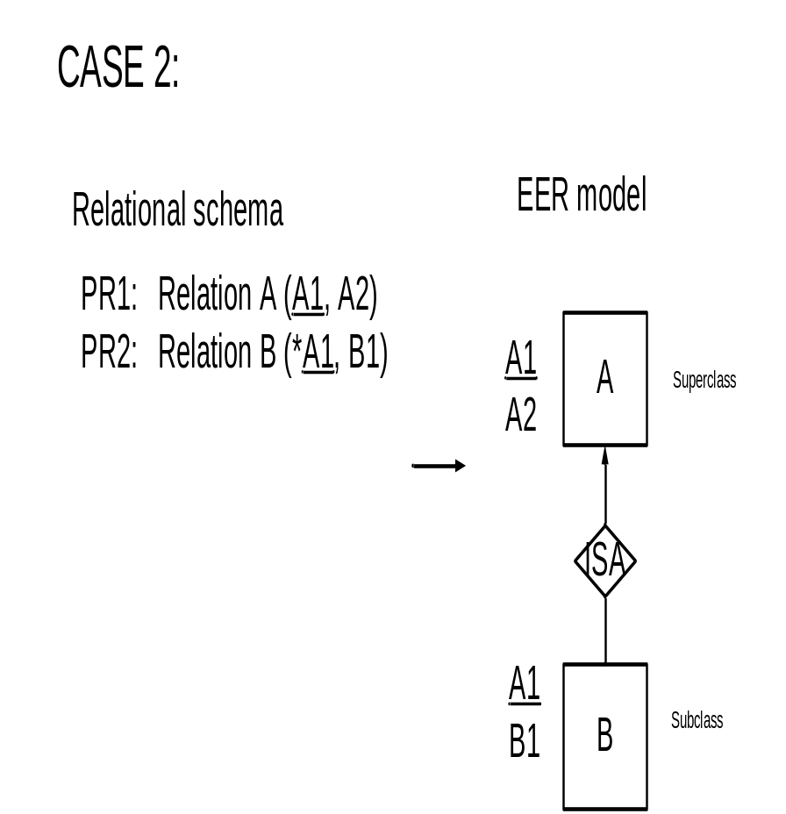
Step 3 Map each PR2 into a subclass entity or weak entity
115/11/08

Slide 19
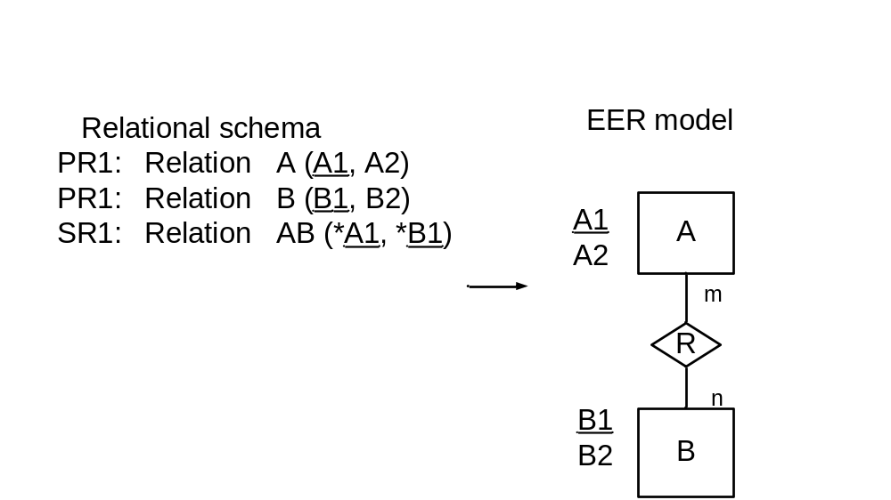
Step 4 Map SR1 into binary/n-ary relationship
115/11/08

Slide 20
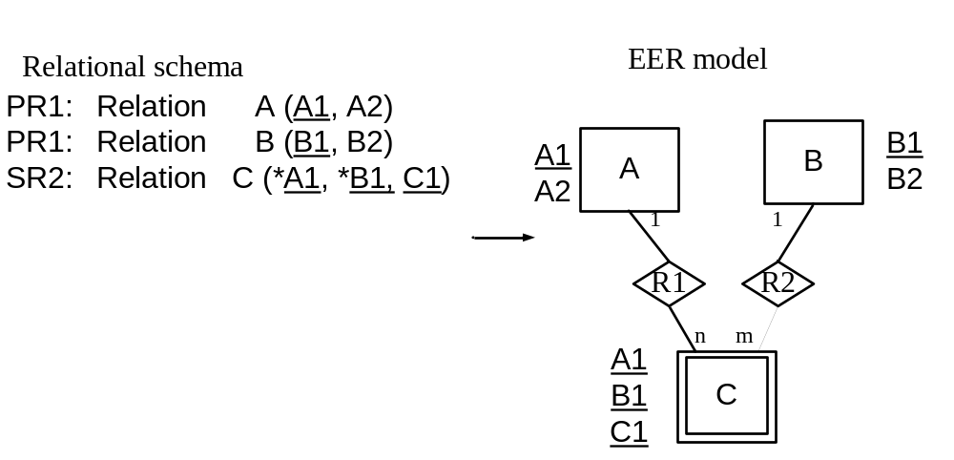
Step 5 Map SR2 into binary/n-ary relationship
115/11/08

Slide 21
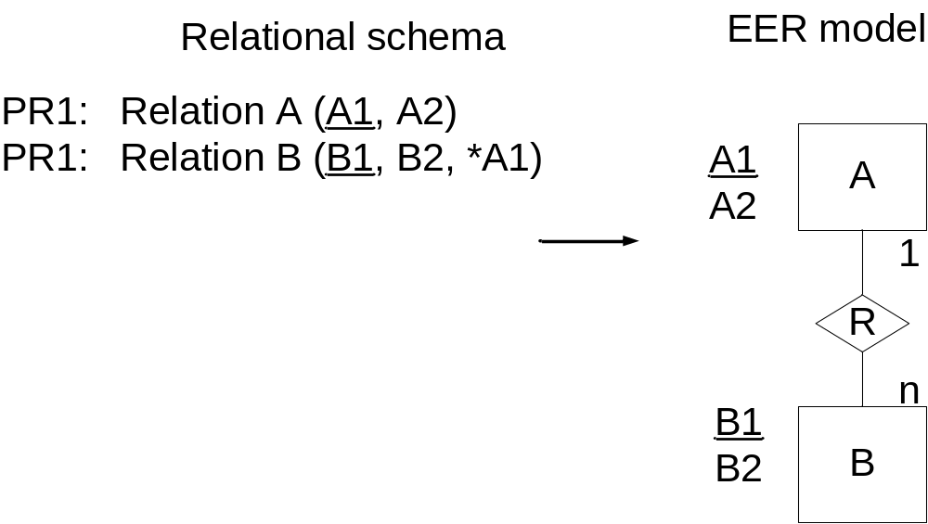
Step 6 Map each FKA into relationship
115/11/08

Slide 22


Step 7 Map inclusion dependency into semantic
If IDs have been derived between two relations, relation A with a as primary key and b’ as foreign key, relation B with b as primary key and a’ as foreign key, then
Case 1. Given ID: a’ a, then entity A is in 1:n relationship with entity B.
Case 2. Given ID: a’ a, and b’ b, then entity A is in 1:1 relationship with entity B.
Case 3. Given ID: a’ a, and b’ b, and a’b’ is a composite key, then entity A is in m:n relationship with entity B.
Step 8 Draw EER model.
Draw the derived EER model as a result of above steps.
115/11/08

Slide 23
An university enrollment system:
    Relations:
    Department (Dept#, Dept_name,)
    Instructor (*Dept#, Inst_name, Inst_addr)
    Course (Course#, Course_location)
    Prerequisite (Prer#, Prer_title, *Course#)
    Student (Student#, Student_name)
    Section (*Dept#, *Course#, *Inst_name, Section#)
    Grade (*Dept#, *Inst_name, *Course#, *Student#, *Section#, Grade)
115/11/08

Slide 24
Relations and attributes classification table
    Relation Rel Primary- KAP KAG FKA NKA
    Name Type Key_____ ________ ________ ________ _________ _________
    DEPT PR1 Dept# Dept_name
    INST PR2 Dept# Dept# Inst_name Inst_addr
    Inst_name
    COUR PR1 Course# Course_location
    STUD PR1 Student# Stud_name
    PREP PR1 Prer Course# Prer_title
    SECT SR2 Course# Course# Section# Inst_name
    Dept# Dept#
    Section#
    Inst_name Inst_name
    GRADE SR1 Inst_name Inst_name Grade
    Course# Course#
    Student# Student#
    Dept# Dept#
      Section# Section#
115/11/08

Slide 25
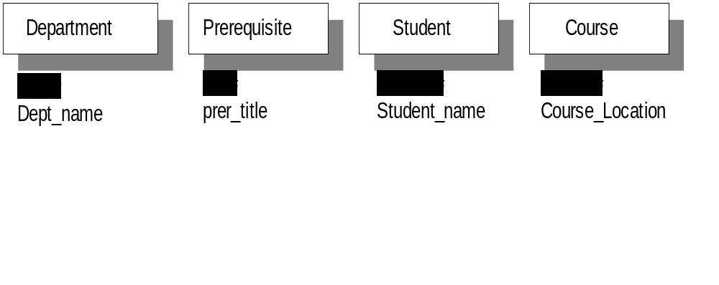
Step 2. Map each PR1 into entity
115/11/08

Slide 26
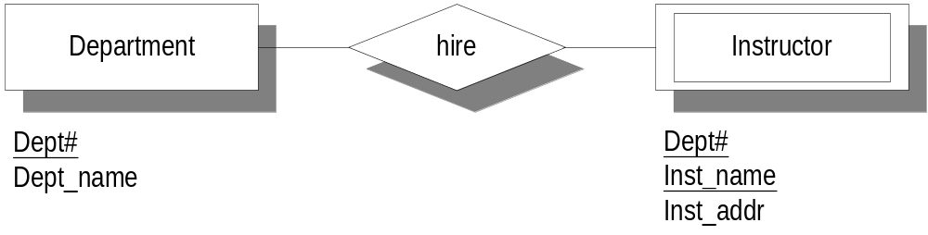
Step 3. Map each PR2 into weak entity.
1
n
115/11/08

Slide 27
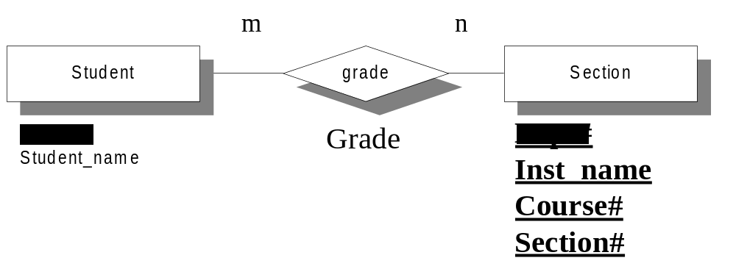
Step 4. Map SR1 into binary/n-ary relationship.
115/11/08

Slide 28
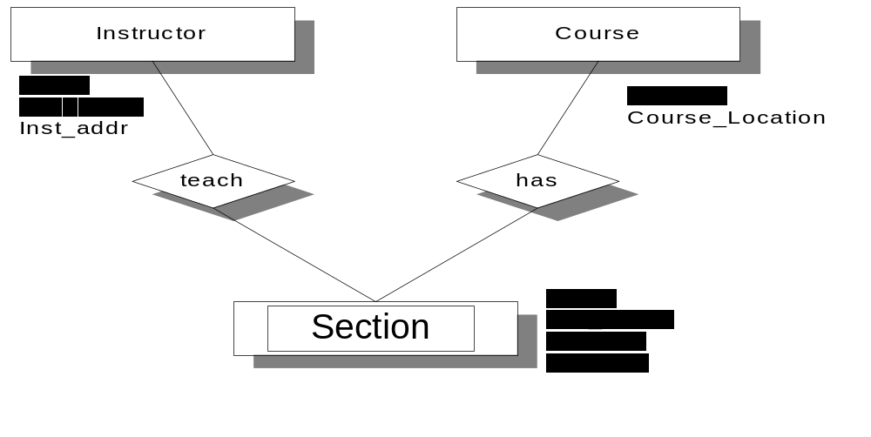
Step 5. Map SR2 into binary/n-ary relationship
1
1
n
n
115/11/08

Slide 29
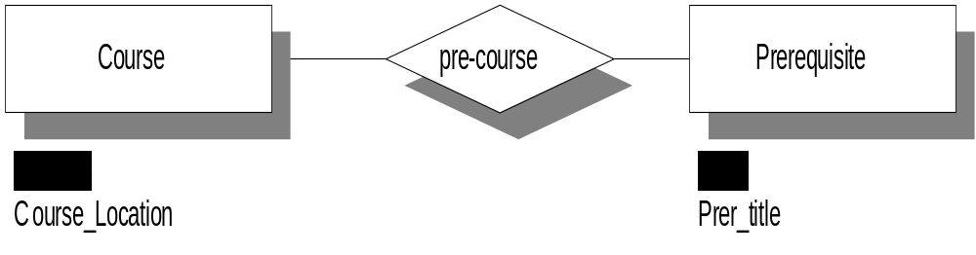
Step 6. Map each FKA into relationship
1
1
115/11/08

Slide 30
Step 7. Map each inclusion dependency into semantics (binary/n-ary relationship)
Given derived inclusion dependency Derived Semantics
Instructor.Dept# ⊆ Department.Dept# n:1 relationship between entities
Instructor and Department
Section.Dept# ⊆ Department.Dept#
Section.Inst_name⊆ Instructor.Inst_name
Section.Course# ⊆ Course.Course# 1:n relationship between entities
Instructor and Section
and between Course and Section.
Grade.Dept# ⊆ Section.Dept#
Grade.Inst_name ⊆ Section.Inst_name
Grade.Course# ⊆ Section.Course#
Grade.Student# ⊆ Student.Student# m:n relationship between
relationship Section and entity Student.
Prerequisite.Course# ⊆ Course.Course#
Course.Prer# ⊆ Prerequisite.Prer# 1:1 relationship between Course and
Prerequisite
115/11/08

Slide 31
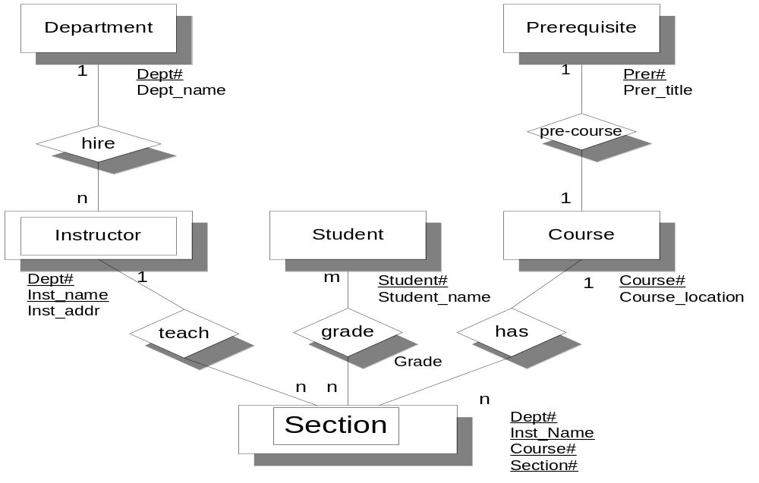
Step 8. Draw EER model.
115/11/08

Slide 32
Reading assignment
Chapter 3 Schema Translation in “Information Systems Reengineering and Integration” by Joseph Fong, published by Springer Verlag, 2006, pp. 115-121.
115/11/08

Slide 33
Review question 2
What are the major differences between Generalization and Categorization in terms of data volume (data occurrences) in their related superclass entity/entities and subclass entity/entities?
Is there any special case such that these two data semantics can be overlapped?
115/11/08

Slide 34
Tutorial Question 2
In a reverse engineering approach, translate the following relational schema to an Entity-relationship model.
Order (Order_code, Order_type, Our_reference, Order_date, Approved_date, *Head, *Supplier_code)
Supplier (Supplier_code, Supplier_name)
Product (Product_code, Product_description)
Department (Department_code, Department_name)
Head (Head, *Department_code, Title)
Order_Product (*Order_code, *Product_code, Qty, Others, Amount)
Note (*Order_code, Sequence#, Note)
where underlined are primary keys and prefixed with ‘*’ are foreign keys.
115/11/08

